Slide 1


Introducing Drushim4Miluim
Welcome to Drushim4Miluim, the innovative platform bridging the gap between reserve units and eager volunteers.
Submitters:
Oria Tzadok - 315500157
Noy Rosenbaum - 206530172
Tal Tosiano - 208846600
Sagi Azulai - 207544230
Elad Shoham - 205439649
Aaron Luchan - 336389515

Slide 2
Our Team
Noy Rosenbaum
Tal Tosiano
Expert in crafting user profiles, diagrams and powerpoint
Specialized in positions management and search.
Sagi Azulai
Oria Tzadok
Architected the Recruiter home and the main debugger
Engineered the backend and front side.
Aaron Luchan
Elad Shoham
Designed the main component, diagram and Git master.
Mastered the overall Design.

Slide 3
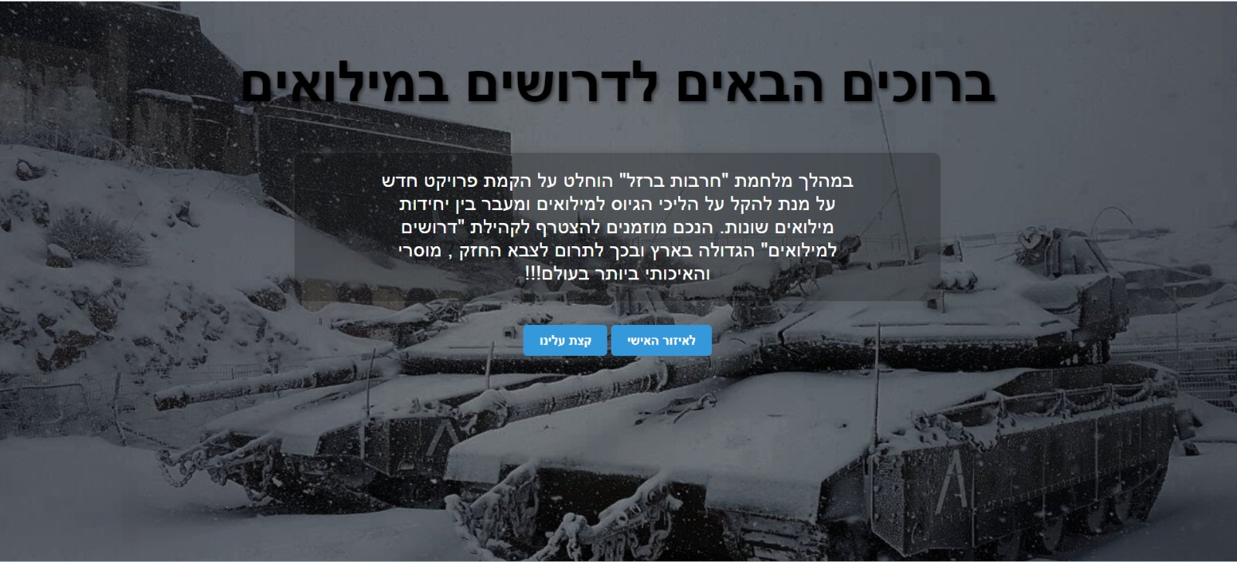
Connecting Volunteers and Recruiters
Drushim4Miluim is the nexus for discharged soldiers seeking to volunteer and recruiters from reserve units.

Slide 4

Addressing Uncertainty
1
October 7th Events
Onset of widespread uncertainty among the community.
2
Need Identified
Discharged soldiers seeking to volunteer and contribute.
3
Our Solution
Drushim4Miluim offers a clear path for volunteers and recruiters.

Slide 5
System’s Requirements
Description | User Type | Functional/Not Functional | Sub type | Priority | Notes
Volunteer Profile | Volunteer | Functional | Editing data | High | The profile shows the current information about the box that is stored in this database contains contact information, and details about the volunteer's military and service and services.
Recruiter Profile | Recruiter | Functional | Editing data | High | The profile contains the details with which the recruiter registered and the option to edit them.
Sign in/up Volunteer | Volunteer | Functional | Data | High | The reserve volunteer must fill in the following information when registering: Full name, email address, phone number, username, password, district, city and street, In addition, he must also fill in details about the military service: Release date, service type (supporting fighter or job), rifleman, authority, profile, age and current assignment to the reserves.
Sign in/up Recruiter | Recruiter | Functional | Data | High | The recruiter must fill in the following details: Full name, email address, username and password (the volunteer does not need the recruiter's details, so the recruiter fills in fewer details, all the details can be edited.

Slide 6

Volunteer Features
1
Profile Customization
2
Position Search
3
Application History
Search for and apply to available positions.
Volunteers can edit their personal details.
Access the last 5 positions applied to - a custom feature.

Slide 7
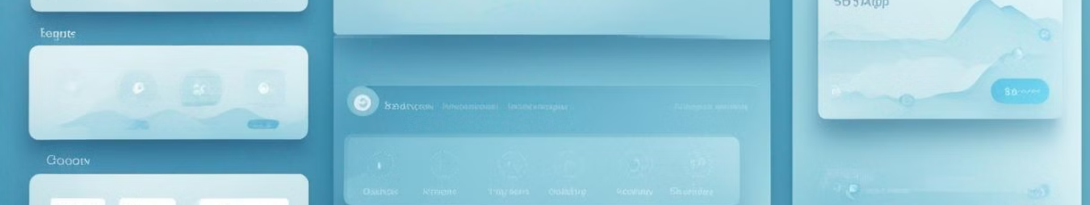
Recruiter Features
1
Profile Management
2
Volunteer Search
3
Position Posting
Find volunteers with custom filters. - A custom feature
Add new positions for volunteers to apply.
Recruiters can update their profiles.
4
Filter Application
Edit/Delete volunteers that applied for a certain position.

Slide 8

Volunteer Workflow
Sign Up
1
Choose to register as a Volunteer.
2
Profile Setup
Edit profile details and preferences.
Position Application
3
Apply to positions that match your skills.

Slide 9
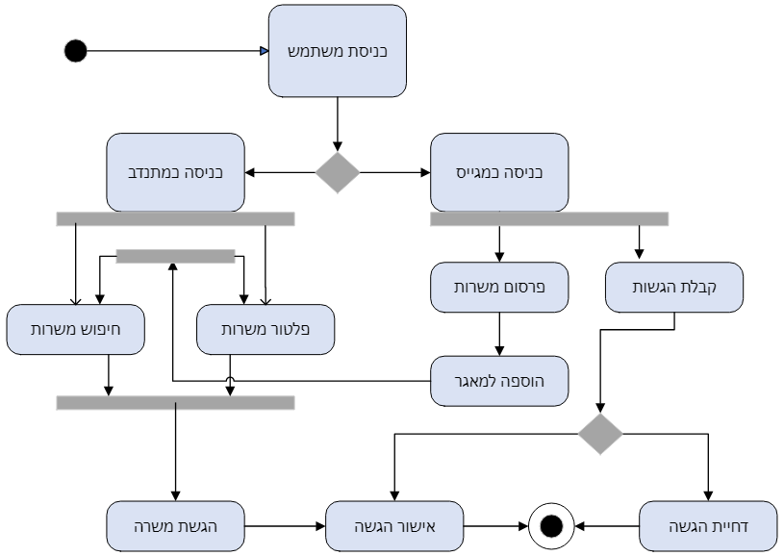
Activity Diagram

Slide 10




Recruiter Workflow
Recruiter Registration
Sign up as a Recruiter.
Volunteer Management
Search and manage volunteer applications.
Position Management
Add and edit positions for volunteers.

Slide 11

Main Features
Sign In/Up
Easy user registration process.
Volunteer
Build and showcase his profile and search for relevant positions and apply for them
Recruiter
Recruiters can filter and select suitable volunteers.

Slide 12
Technology Stack
Our site is built with React JS, Express for backend, and MongoDB for the database. The structure is page-based with components.

Slide 13
Expectations VS Reality
We planned to implement Message button to alert new notification, but in the end we decided not to burden the user so we took it down

